Slide 1

DeepNeuron Training
Layers, Models and Techniques

Slide 2
Today
Why we can’t just use basic linear/affine layers
CNN theory
Fully Connected / Dense / Linear
Convolutional
Non-linearities
ResNet as a case study
Evaluating models
Tuning hyperparameters
Notes:
Mention that people should have the slides with them while they watch, lots of links

Slide 3
Linear Layer Problems

Slide 4
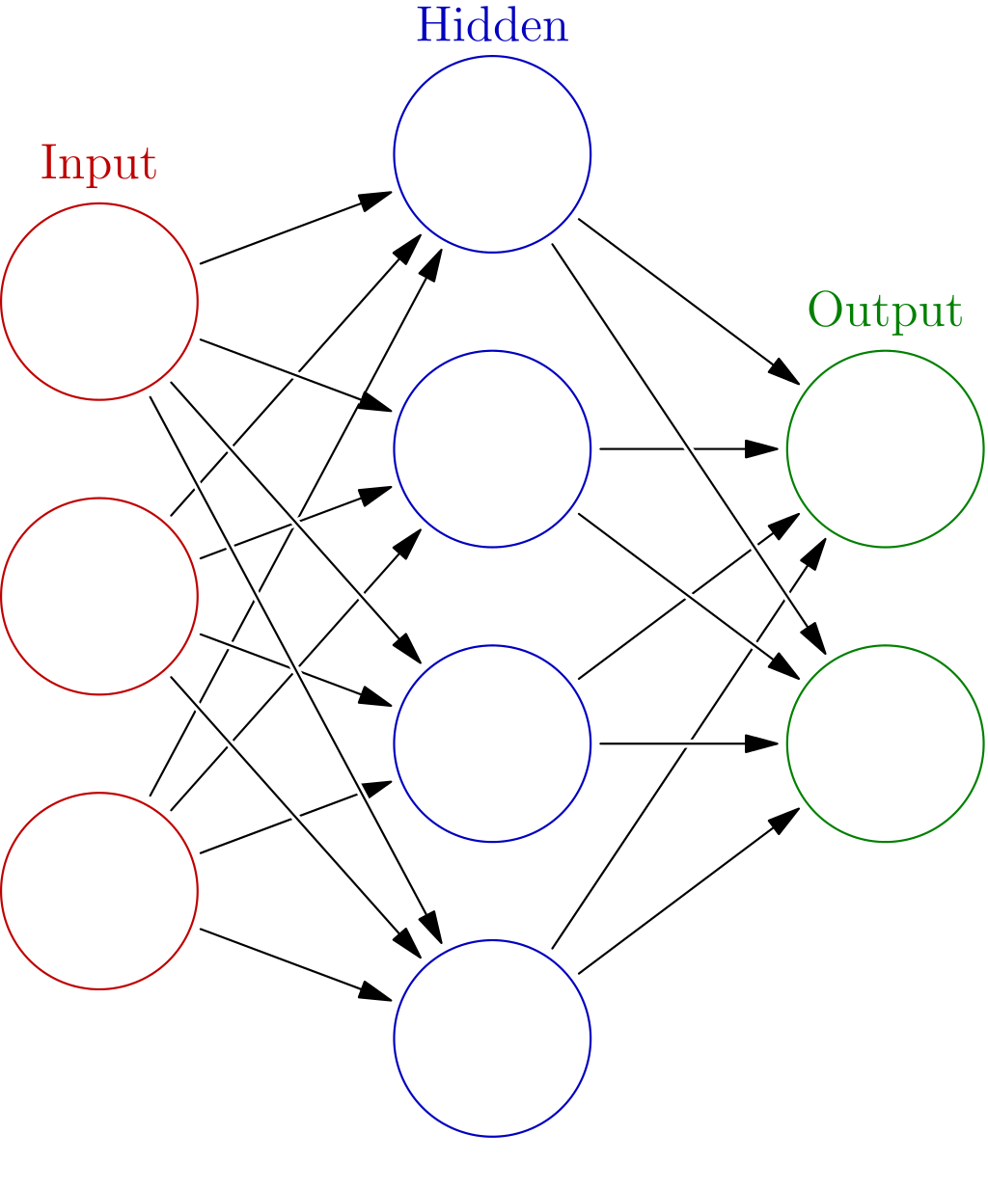
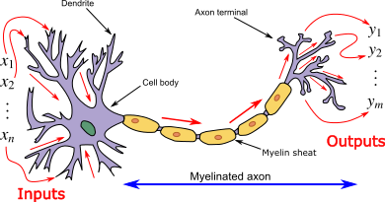
Fully Connected Layers
Used in all neural networks, not just CNNs
Most basic layer, where every node in the layer is connected to every node in the previous layer. Every connection has some weighting attached to it
Artificial Neural Networks - Wikipedia

Slide 5
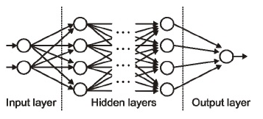
Connecting Every Node
High computational complexity
Doesn’t naturally find “patterns” or “features”
Source: https://medium.com/@Ana_Caballero_H/
Notes:
This is the point we’ve been building up to, neural networks essentially form the backbone of deep learning, the aim is to essentially find an approximation of an unknown function. Neural nets are made up of many artificial neurons, known as perceptrons. The data is first passed through the input layer, the first layer of the network. The hidden layers take the outputs of the input layers to perform tasks on the data to sequentially pass the output in and out of the consecutive layers. Finally an output data is generated, which as we mentioned before, is an approximation of an unknown function. This movement of the data is known as forward propogation. The hidden layers are called “hidden” for a reason, as we cannot see the what is being processed in there, only the input and output layers are visible to us. Each

Slide 6
CNN Theory

Slide 7
CNN
Widely used for for visual applications
Helps us detect “features” in images
For example:
Lines
Shapes
Colours
More complex features like faces can be detected by having multiple convolutional layers stacked

Slide 8
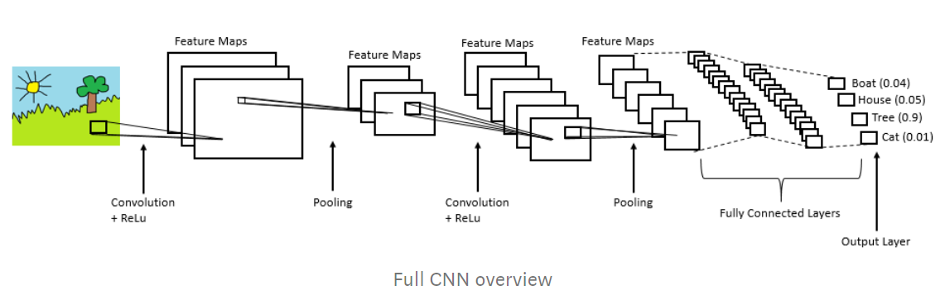
Convolutional Layers
Extracts features (i.e. patterns) from pixels
Can work in 2D or 3D (or any other dimensionality)
https://towardsdatascience.com/simple-introduction-to-convolutional-neural-networks-cdf8d3077bac

Slide 9
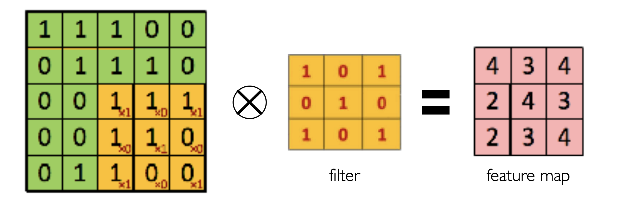
Feature Map
Convolutional layers are composed of kernels, which operate across the input channels
© MIT 6.S191: Introduction to Deep Learning
Notes:
Point out that the circle with the cross in it is a dot product, producing a scalar output

Slide 10
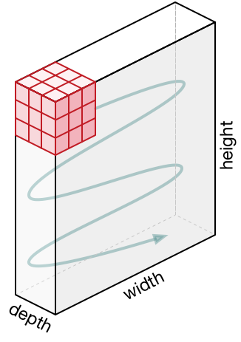
Convolving Over the Input
Kernel convolves over every layer (channel) of the input
Kernel multiplies with input forming a new representation (channel)
Source: https://towardsdatascience.com/a-comprehensive-guide-to-convolutional-neural-networks-the-eli5-way-3bd2b1164a53

Slide 11
Convolution Visualiser
Parameters (first three are most important):
Kernel Size - increases spacial awareness, but also computation cost
Stride - reduces complexity by skipping pixels
Padding - helps maintain original input size
Dilation - reduces complexity by adding zeros to kernel, spreading out operation
You can use the tool linked below to help visualise these parameters
https://ezyang.github.io/convolution-visualizer/index.html
Notes:
Mention 3x3, padding=1 preserves input size, padding 1 stride 2 halves input size

Slide 12
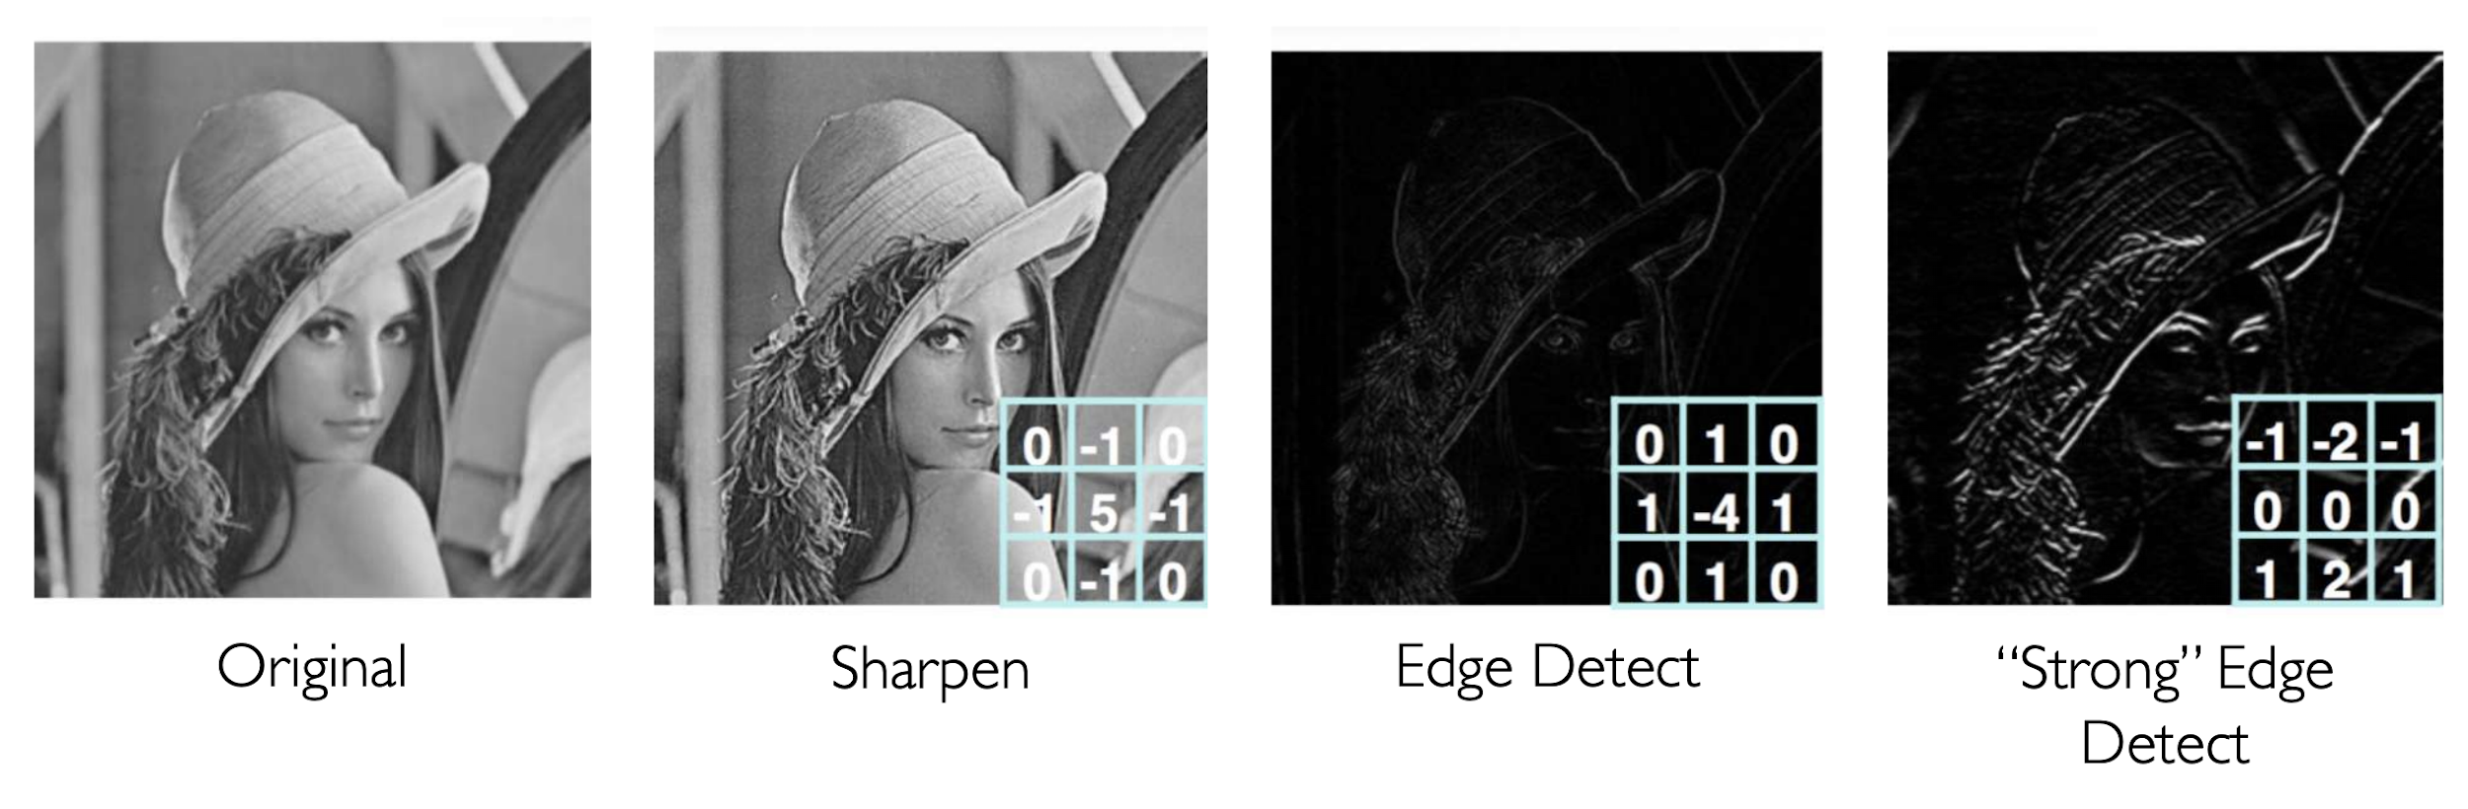
CNN Output Example
© MIT 6.S191: Introduction to Deep Learning
Notes:
Explain that a convolutional layer is built up of multiple kernels, which make multiple feature maps

Slide 13
Advanced Layers

Slide 14
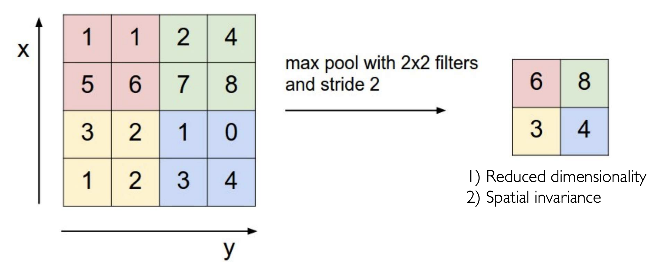
Max Pooling
Downsample the data but still keep the important information
Notes:
Can also include average pooling. Max pooling performs better in the middle of the net, especially as a downsampling tool, but there are some cases where average pooling is necessary

Slide 15
Batch Normalisation
“Normalises” data - means we standardise the means and variances of the inputs to a layer
Increases stability and speed of training
Stops exploding gradient problems
Numerous theories for exactly why batch normalisation is effective, generally agreed to be either a smoothing of the objective landscape or mitigating internal covariate shift (not important to understand)

Slide 16
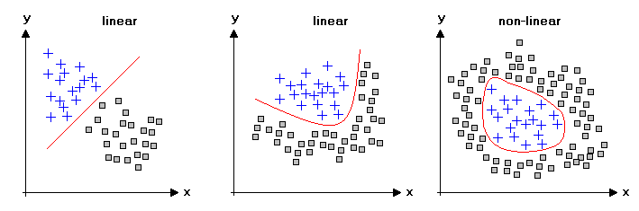
Activation Functions (Non-Linearity)
Most real world data can’t be modelled by a linear function, so we need to introduce non-linearities
Statistics4U
Notes:
Mention that we need a non-linearity between every layer, otherwise those two layers collapse into a single linear layer

Slide 17
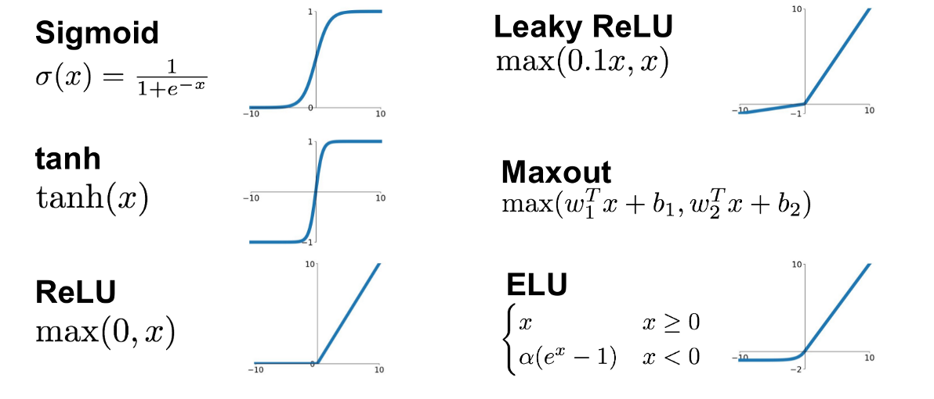
Non-Linearities - Sigmoid
Complete Guide to Activation Functions

Slide 18
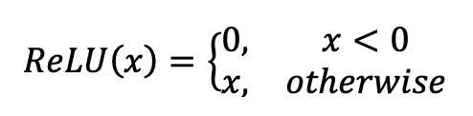
Non-Linearities - ReLU
Complete Guide to Activation Functions
Notes:
Much cheaper than Sigmoid (one if statement compared to multiple maths operations). If ignoring computation speed - sigmoid stops forward pass exploding, relu stops backwards pass disappearing. This means that sigmoid can be more stable (anecdotally true from RL), but in general ReLU is better because of some nice properties when back-propagating loss, meaning training is faster.

Slide 19
Improved Model Architecture: ResNets

Slide 20
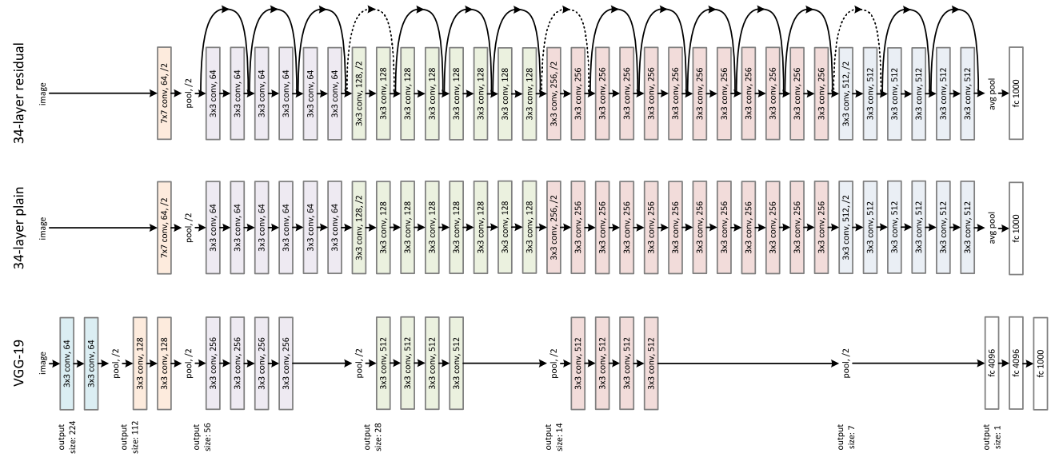
Deeper Models
We can stack a number of layers on top of each other
This increases complexity and effectiveness of models
But when does adding more layers become redundant?
Deep Residual Learning for Image Recognition

Slide 21
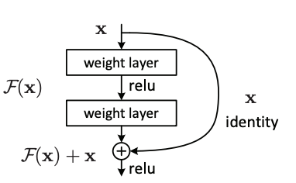
Skip Connections
Skip connections allow the input to be passed through a model, unprocessed by any layers
This allows gradients to flow backwards through the model much easier
Deep Residual Learning for Image Recognition
Notes:
In the forward pass, the model learns to favour the convolutional path. On the backwards pass, gradients flow back through both the convolutional path and the skip connection, meaning that no matter how small the gradients may become for the convolutional path, there will be enough gradient flowing back through the skip connection to allow the previous layers to train

Slide 22
ResNets
A ResNet (residual network) is a type of CNN
ResNet’s allow gradients to flow backwards more easily, which allows models to train faster, and helps with stability
ResNets consist of “blocks” of convolutional layers, with skip connections jumping over the convolutional blocks
They use strided convolutions instead of downsampling (i.e. maxpool)
Deep Residual Learning for Image Recognition

Slide 23
Breakout Time - 10 mins
Things you might want to ask about:
What is a ReLU?
How does a fully connected layer work?
Why do we need a skip connection?
Why do we need non-linearities?
How does a kernel work?
What are the two most important improvements in a ResNet?
Explain how and why they work

Slide 24
PyTorch Custom Models

Slide 25
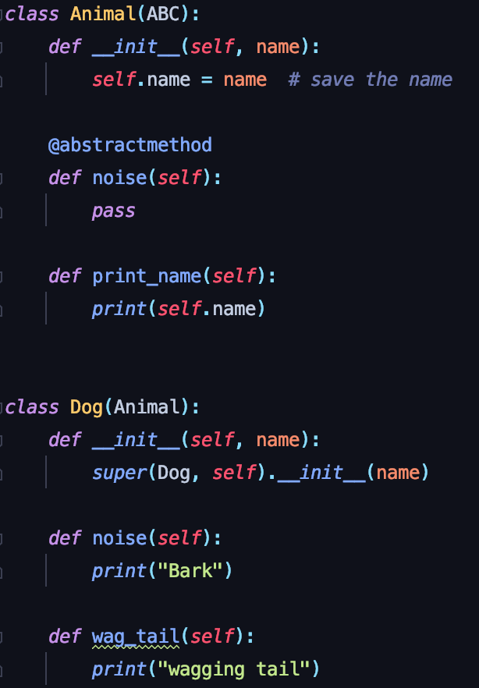
Python Class Inheritance
Parent class defines some attributes and methods.
Abstract methods need to be implemented by the child class
Parent class also has some methods which the child class can use
Child class Dog extends Animal, and calls super()
Child class must implement noise()
Child class can define its own methods

Slide 26
Homework Mini-Project
Instead of per-workshop homework we have one larger task
Current goal - find a dataset
You can use one of our examples or one of your own
Stick with something relatively simple (i.e. classification)
The GitHub Repository contains instructions and guidance
Work with your partner!

Slide 27
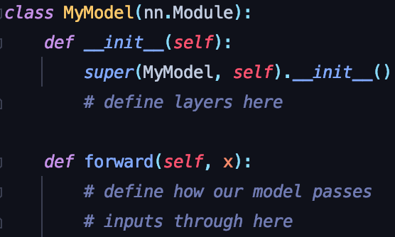
PyTorch Model Creation
Generally, we want to create our own models, to complete our own tasks
PyTorch lets us do this easily, with Module’s
Module’s are the parent class, our own models are the child classes
Our model extends nn.Module
Our model calls super()
Our model implements forward()
Notes:
Labour the point that these are PyTorch Modules, not related to lightning

Slide 28
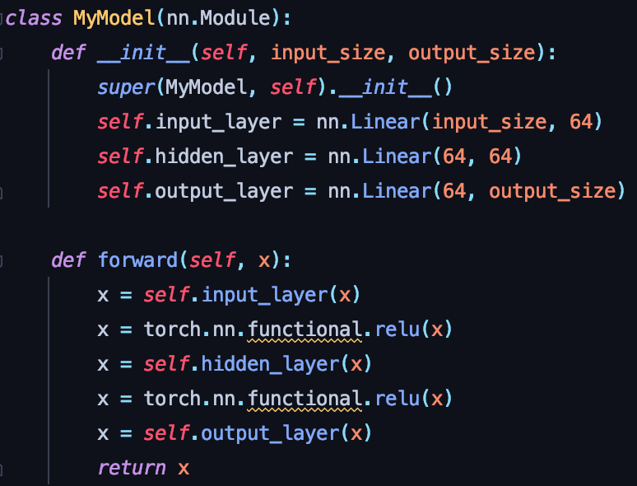
Define three layers:
input layer
hidden layer
output layer
All three of these layers are fully connected layers, called Linear layers in Pytorch
In our forward method:
Pass the input through the input layer
Then through a ReLU function
Repeat for the hidden layer
Pass through the output layer
Return result

Slide 29
What Have We Made?
3 layer network
Variable size for the first (input) and last (output) layers
Middle (hidden) layer has 64 perceptrons
Artificial Neural Networks - Wikipedia

Slide 30
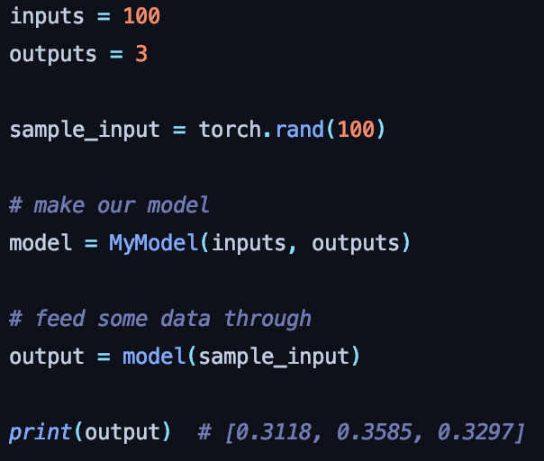
Model Usage
Define the input and output size
Get some random input, of the same size
Initialise the model
Feed the random input through the model
Print the output

Slide 31
Breakout: Code a Model

Slide 32
Your task
Code a model which extends nn.Module and has the following structure:
Convolutional Layer (3 input channels, 7 output channels, kernel size = 5)
Max Pool (kernel size = 2, stride = 2)
Convolutional Layer (7 input channels, 14 output channels, kernel size = 5)
Fully Connected Layer (Figure out the input size, output size is 64)
Fully Connected Layer (input size is 64, output size is 10)
Your model should use the ReLU function between each layer. More in-depth explanation of how you should define the forward pass in the Colab notebook.

Slide 33
Hints
All layers are found in torch.nn:
Fully Connected Layer: Linear(num inputs, num outputs)
Max Pooling: MaxPool2d(kernel size, stride)
Convolutional Layer: Conv2d(input channels, output channels, kernel size, stride)
Define your layers in the __init__ method of your model
The ReLU function can be found in torch.nn.functional.relu()
Use our Convolutional Layer Size Calculator to calculate the output size from your convolutional layers (you’ll need to make a copy)
Can be useful to print tensor.shape if you’re having matrix multiplication issues

Slide 34

Thanks for attending! Please take the time to fill out the feedback form.
deepneuron.org

